Slide 1

Road Condition Analysis using Deep Learning
Team 16 – Route 0x78

Slide 2

The Critical Challenge
Unknown Road Conditions
Teams working in disaster response and UN field missions often navigate unmarked or outdated roads. A route that appeared paved six months ago might now be gravel—or worse.
Time lost on impassable routes
Increased operational risk
Mission delays and inefficiencies

Slide 3



Our Solution Overview
Capture
Classify
Visualize
Record road conditions using Android device camera while collecting GPS and orientation data
AI-powered ResNet classifier labels surfaces as asphalt, paved, or unpaved with confidence scores
Results rendered on interactive maps using open geospatial standards for universal compatibility

Slide 4
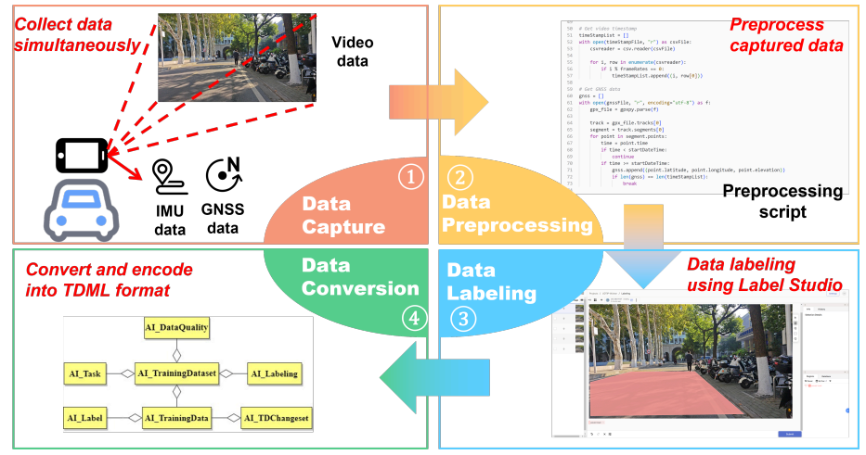
Standards-Based Architecture
GeoPose 1.0 Integration
TDML-AI JSON Structure
Each captured frame synchronized with GNSS coordinates and device orientation using OGC GeoPose standard for precise spatial referencing
Machine learning results packaged in standardized format ensuring labels, confidence scores, and context data travel together seamlessly
Urban Digital Twin Alignment
Built following UDTIP engineering specifications to integrate with larger Urban Digital Twin ecosystems and mission planning systems

Slide 5
Technical Implementation
Deep Learning Pipeline
ResNet Architecture: Chosen for optimal balance of accuracy and mobile efficiency
Training Dataset: RTK-style road dataset augmented with field captures
Seven Categories: Grouped under asphalt, paved, and unpaved classifications
Real-time Processing: On-device inference for immediate results

Slide 6

Mobile Application Demo
01
Capture Road Segment
Tap Record for video or Snap for single frame capture with automatic GPS and orientation logging
02
Extract and Process Frames
FFmpeg samples frames deterministically, synchronizes with GNSS timestamps and device pose data
03
Classify Surface Type
ResNet model analyzes each frame and assigns surface classification with confidence metrics
04
Upload to Cloud
Images and GeoPose/TDML files automatically sync to Firebase for instant map visualization

Slide 7


Firebase Integration & Data Flow
Android App
Collects GeoPose & TDML-AI
Interactive Map
Firebase Data Flow
Realtime Upload
Visualizes GeoPose & model output
Push to Firebase Cloud Storage
Sync & Rules
Cloud Processing
Security and realtime listeners
Normalize GeoPose and TDML-AI
Seamless cloud integration enables real-time synchronization between field teams and mission planners using Firebase's robust infrastructure.

Slide 8
Key Challenges Overcome
Data Imbalance
Mobile Deployment
Real-time Performance
Underrepresented classes like "bad unpaved" required targeted field collection and strategic data augmentation techniques to achieve model accuracy
Converting and optimizing neural networks for Android, integrating camera, GNSS, and storage systems into responsive user interface
Balancing classification accuracy with processing speed to maintain smooth user experience during field operations

Slide 9
Development Roadmap
Dataset Expansion
Enhanced Visualization
Scale training data through partnerships with humanitarian field teams across diverse geographic regions and road conditions
Develop richer map layers with 3D context, elevation profiles, and integration with mission planning dashboards
1
2
3
On-Device Optimization
Implement model quantization and edge computing techniques to reduce inference time and bandwidth requirements

Slide 10

Real
Change
With our application, we can tackle the issue we mentioned earlier.
Road Condition Analysis using Deep Learning—from phone camera to operational map, in minutes.
Built on open standards, ready for humanitarian logistics teams worldwide.

